Slide 1
Lesson 11
Budgets
Notes:
https://www.youtube.com/watch?v=jVXgWGK9Kr8

Slide 2
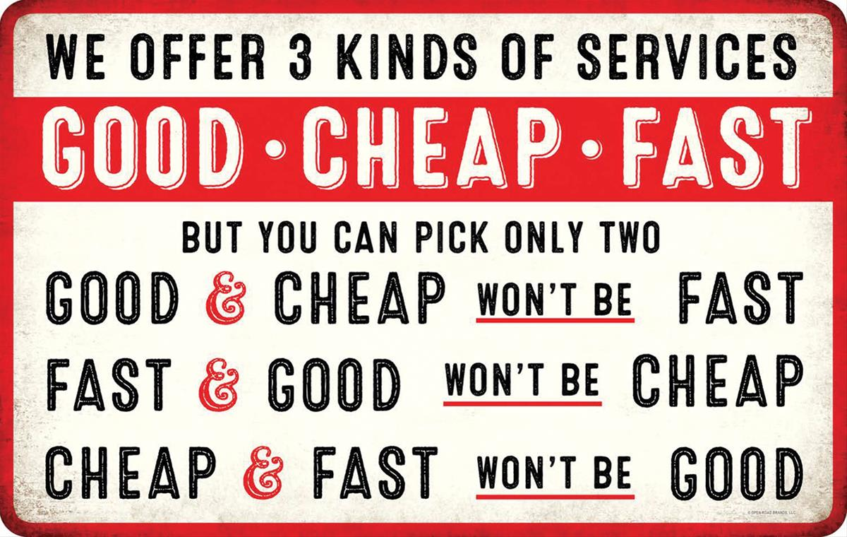
Triple Constraint
Notes:
The Triple Constraint (also called the Project Management Triangle) refers to the three fundamental dimensions that govern every engineering project:
Cost – the resources (money, labor, materials) available.
Schedule (Time) – the deadlines and milestones that must be met.
Performance (Scope/Quality) – the technical requirements, capabilities, and mission objectives.
In space systems, these are the core trade-off axes: changing one inevitably impacts the others.
How It Works
If you want more performance (e.g., higher resolution payload, more ∆v, longer life), you usually need more cost and/or more time.
If you want lower cost, you likely reduce scope/performance, or you may need to compress the schedule (which often increases technical risk).
If you want faster delivery, you need more funding (to parallelize work, pay for overtime) or you accept reduced performance.
Space Systems Examples
James Webb Space Telescope (JWST): Original plan: $1B, launch in 2007. Actual: $10B+, launched 2021. → Performance was non-negotiable (infrared observatory), so cost and schedule ballooned.
CubeSat Missions: Budgets and schedules are constrained (student or low-cost programs). → To meet cost/time, performance is reduced (smaller payloads, limited power).
Military Reconnaissance Satellites: Schedule and performance are often prioritized (must meet national security needs), so cost can grow significantly.

Slide 3
Budgets
A systematic plan that defines, allocates, and manages limited resources (mass, power, cost, propellant, volume, reliability, time, etc.) across all spacecraft subsystems to ensure mission feasibility and success.
Why are budgets important?
They act as constraints in design trades (e.g., increasing payload mass means decreasing margin elsewhere).
They are living documents, updated throughout design, integration, and test. → They ensure design remains feasible.
They provide a common language for engineers, managers, and stakeholders to evaluate feasibility.
They ensure the system-of-systems stays balanced — no single subsystem can grow unchecked without jeopardizing the whole mission.
Budget = a systems engineering tool for managing scarce resources
Notes:
SMAD - Space Mission Analysis and Design 3rd Edition

Slide 4
Selected Budgeting Terms
SWAP-C: Size, Weight, & Power, (Cost)
Margin: a spare amount or measure or degree allowed or given for contingencies or special situations.
Margins evolve with mission design phases, e.g.
20% at SRR
15 % at PDR
10% at CDR
Allocation – The portion of a resource (mass, power, cost, etc.) assigned to a subsystem or component.
Overrun: When actual resource usage exceeds budgeted amount
ROM: Rough Order of Magnitude
BOM: Bill of Materials
MEL: Master Equipment List
Notes:
A Rough Order of Magnitude (ROM) estimate is a very early, high-level estimate of cost, schedule, or other resources for a project.
It is intended to give stakeholders a ballpark figure, not a precise prediction.
Used in the conceptual or feasibility phase when limited data is available.
A Bill of Materials (BOM) is a comprehensive list of parts, components, assemblies, and materials required to build a product or system.
It’s essentially the recipe for the hardware.
Includes not only the components but also quantities, specifications, and sometimes vendor details.
In space systems, the BOM covers everything from resistors and chips on a PCB to structural panels, solar cells, fasteners, and even adhesives.

Slide 5
Methods of Budget Estimation
Analogy
→Estimate cost, mass, power, etc. by comparing to similar past projects.
Parametric
→Uses statistical cost-estimating relationships (CERs) or mathematical models to relate system parameters (like mass, power, or complexity).
Engineering Build-Up
→A detailed estimate built by summing up contributions from each component or line item.
Notes:
1. Analogy Method
Definition: Estimate cost, mass, power, or other resources by comparing to similar past projects.
How it works:
Identify a prior spacecraft or subsystem with similar function/scale.
Adjust for differences (size, technology, mission requirements).
Example:
“Our CubeSat payload is similar to a camera flown on Mission X, which weighed 5 kg and consumed 8 W. Ours is slightly more capable, so we’ll estimate ~6 kg and 10 W.”
Pros: Quick, requires minimal data, useful early in concept studies.
Cons: Accuracy depends on how close the analogy is; risk of overlooking unique features.
2. Parametric Method
Definition: Uses mathematical models or statistical relationships between a system parameter and cost/power/mass.
How it works:
Fit equations from historical data: $\text{Cost}=a⋅\left(\text{Mass}{\left.)\right.}^{b}\right.$
Widely used in NASA/DoD cost models (e.g., NAFCOM, SEER).
Example:
Spacecraft cost scales with dry mass: “For every 10 kg increase in mass, cost rises by $X million.”
Solar array power output scales with area: “P = η × Area × Solar constant.”
Pros: Provides data-driven estimates, can scale across many designs.
Cons: Requires large historical databases; accuracy limited if new tech or novel missions deviate from trends.
3. Engineering (Bottom-Up) Method
Definition: A detailed estimate built by summing up contributions from each component or line item.
How it works:
Create a work breakdown structure (WBS).
Gather vendor quotes, part specifications, and engineering analyses.
Add everything together with margins.
Example:
EPS subsystem:
Solar cells (200 g),
Batteries (1.5 kg),
Power electronics board (0.5 kg),
Harnessing (0.2 kg) → ~2.4 kg total + 20% margin = 2.9 kg.
Pros: Most accurate, transparent, and defensible; necessary for final design.
Cons: Requires detailed design maturity and more time/resources.
Summary:
Analogy → Best for early concept phases (ROM estimates, feasibility studies).
Parametric → Best for Phase A/B trades when some data exists but design not finalized.
Engineering/Bottom-Up → Best for detailed design and final budgeting (Phase C/D).
Most missions actually use a hybrid approach: start with analogy, refine with parametric models, and finalize with engineering estimates as the design matures.

Slide 6
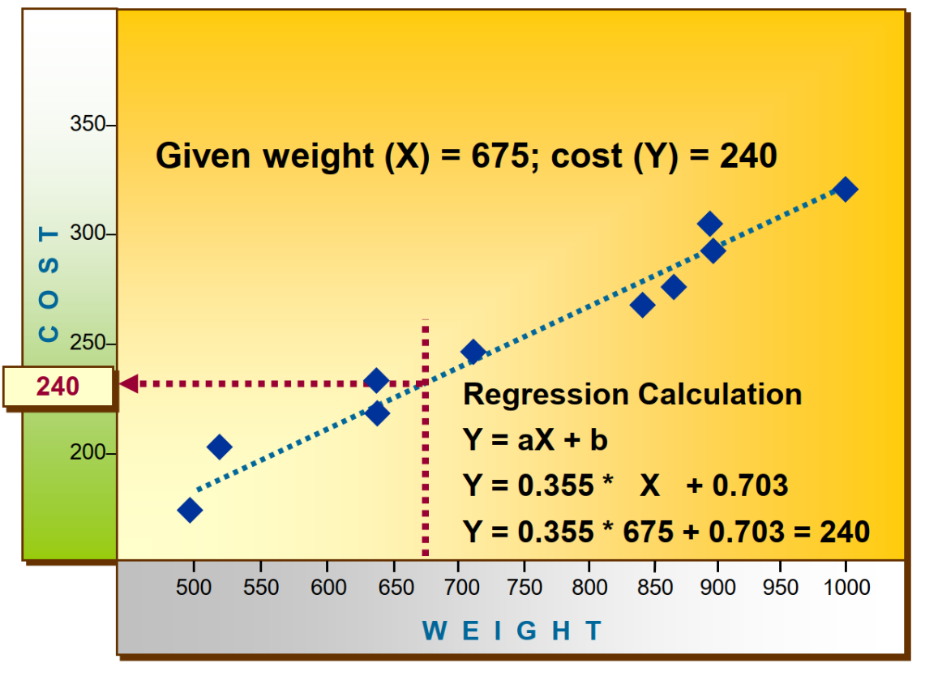
Parametric Budgeting Example
Notes:
Definition: Uses statistical cost-estimating relationships (CERs) or mathematical models to relate system parameters (like mass, power, or complexity) to cost.
How it works:
Build regression models from historical data:
$$\text{Cost}=a⋅\left(\text{Mass}{\left.)\right.}^{b}\right.$$
Apply to your system, based on known parameters.
Example:
“Satellite cost ~ $2M × (mass in kg)^0.65.”
A 1000-kg satellite would cost ~ $100M by this model.
Strengths:
Data-driven and scalable across different sizes/types.
More objective than analogy.
Useful for Phase A/B design trades.
Weaknesses:
Requires a solid historical database.
Not valid if your mission uses novel tech outside the model’s data set.
Accuracy is limited by scatter in the underlying data (±20–50%).

Slide 7
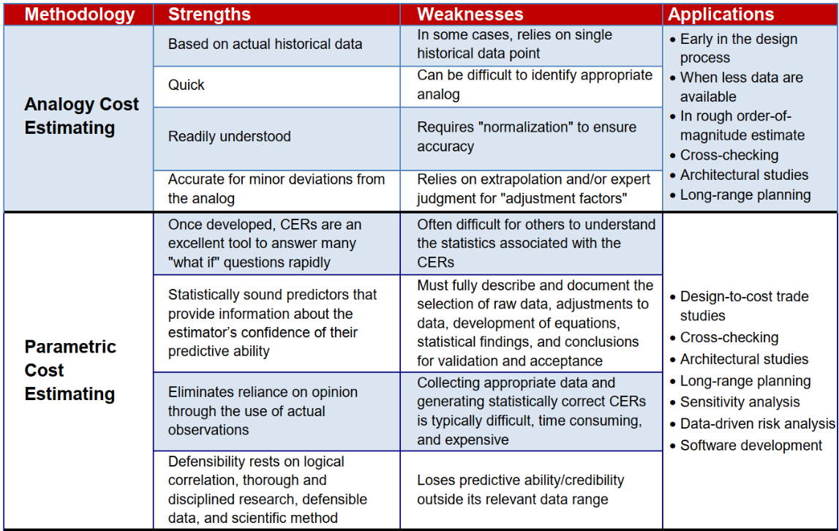
Methods of Budget Estimation (2)
Notes:
1. Analogy Method
Definition: Estimate cost, mass, power, or other resources by comparing to similar past projects.
How it works:
Identify a prior spacecraft or subsystem with similar function/scale.
Adjust for differences (size, technology, mission requirements).
Example:
“Our CubeSat payload is similar to a camera flown on Mission X, which weighed 5 kg and consumed 8 W. Ours is slightly more capable, so we’ll estimate ~6 kg and 10 W.”
Pros: Quick, requires minimal data, useful early in concept studies.
Cons: Accuracy depends on how close the analogy is; risk of overlooking unique features.
2. Parametric Method
Definition: Uses mathematical models or statistical relationships between a system parameter and cost/power/mass.
How it works:
Fit equations from historical data: $\text{Cost}=a⋅\left(\text{Mass}{\left.)\right.}^{b}\right.$
Widely used in NASA/DoD cost models (e.g., NAFCOM, SEER).
Example:
Spacecraft cost scales with dry mass: “For every 10 kg increase in mass, cost rises by $X million.”
Solar array power output scales with area: “P = η × Area × Solar constant.”
Pros: Provides data-driven estimates, can scale across many designs.
Cons: Requires large historical databases; accuracy limited if new tech or novel missions deviate from trends.
3. Engineering (Bottom-Up) Method
Definition: A detailed estimate built by summing up contributions from each component or line item.
How it works:
Create a work breakdown structure (WBS).
Gather vendor quotes, part specifications, and engineering analyses.
Add everything together with margins.
Example:
EPS subsystem:
Solar cells (200 g),
Batteries (1.5 kg),
Power electronics board (0.5 kg),
Harnessing (0.2 kg) → ~2.4 kg total + 20% margin = 2.9 kg.
Pros: Most accurate, transparent, and defensible; necessary for final design.
Cons: Requires detailed design maturity and more time/resources.
Summary:
Analogy → Best for early concept phases (ROM estimates, feasibility studies).
Parametric → Best for Phase A/B trades when some data exists but design not finalized.
Engineering/Bottom-Up → Best for detailed design and final budgeting (Phase C/D).
Most missions actually use a hybrid approach: start with analogy, refine with parametric models, and finalize with engineering estimates as the design matures.

Slide 8
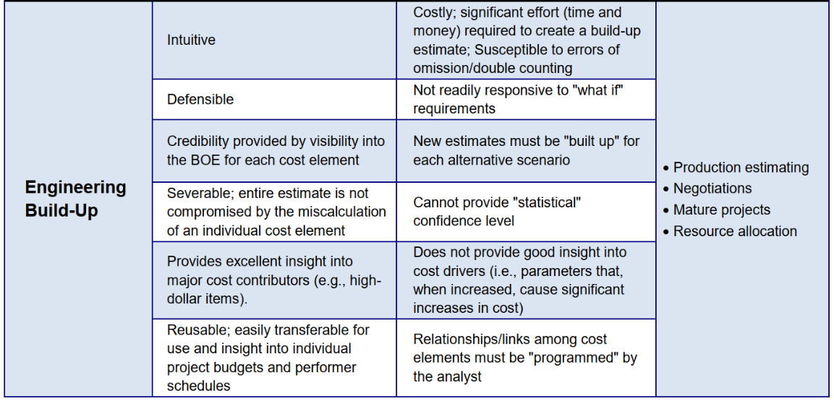
Methods of Budget Estimation (2)
Notes:
1. Analogy Method
Definition: Estimate cost, mass, power, or other resources by comparing to similar past projects.
How it works:
Identify a prior spacecraft or subsystem with similar function/scale.
Adjust for differences (size, technology, mission requirements).
Example:
“Our CubeSat payload is similar to a camera flown on Mission X, which weighed 5 kg and consumed 8 W. Ours is slightly more capable, so we’ll estimate ~6 kg and 10 W.”
Pros: Quick, requires minimal data, useful early in concept studies.
Cons: Accuracy depends on how close the analogy is; risk of overlooking unique features.
2. Parametric Method
Definition: Uses mathematical models or statistical relationships between a system parameter and cost/power/mass.
How it works:
Fit equations from historical data: $\text{Cost}=a⋅\left(\text{Mass}{\left.)\right.}^{b}\right.$
Widely used in NASA/DoD cost models (e.g., NAFCOM, SEER).
Example:
Spacecraft cost scales with dry mass: “For every 10 kg increase in mass, cost rises by $X million.”
Solar array power output scales with area: “P = η × Area × Solar constant.”
Pros: Provides data-driven estimates, can scale across many designs.
Cons: Requires large historical databases; accuracy limited if new tech or novel missions deviate from trends.
3. Engineering (Bottom-Up) Method
Definition: A detailed estimate built by summing up contributions from each component or line item.
How it works:
Create a work breakdown structure (WBS).
Gather vendor quotes, part specifications, and engineering analyses.
Add everything together with margins.
Example:
EPS subsystem:
Solar cells (200 g),
Batteries (1.5 kg),
Power electronics board (0.5 kg),
Harnessing (0.2 kg) → ~2.4 kg total + 20% margin = 2.9 kg.
Pros: Most accurate, transparent, and defensible; necessary for final design.
Cons: Requires detailed design maturity and more time/resources.
Summary:
Analogy → Best for early concept phases (ROM estimates, feasibility studies).
Parametric → Best for Phase A/B trades when some data exists but design not finalized.
Engineering/Bottom-Up → Best for detailed design and final budgeting (Phase C/D).
Most missions actually use a hybrid approach: start with analogy, refine with parametric models, and finalize with engineering estimates as the design matures.

Slide 9
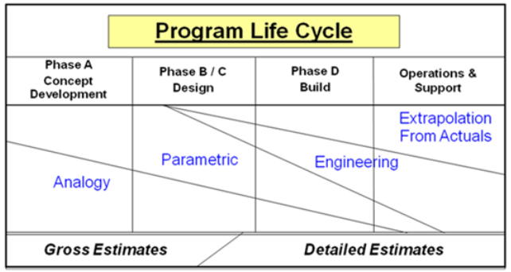
Methods of Budget Estimation (3)
Notes:
Analogy – This method compares the system being developed to systems that have already been completed. Estimates are obtained from actual mass and power distributions of the previous system. We can also use some scaling factors to help improve these estimates if our satellite will have different requirements.
Engineering – This method involves compiling all of the individual masses and powers in order to get a budget. However, early in the design process the individual components aren’t known, often making this method impractical until the later stages of development.
Summary:
Analogy → Best for early concept phases (ROM estimates, feasibility studies).
Parametric → Best for Phase A/B trades when some data exists but design not finalized.
Engineering/Bottom-Up → Best for detailed design and final budgeting (Phase C/D).
Most missions actually use a hybrid approach: start with analogy, refine with parametric models, and finalize with engineering estimates as the design matures.

Slide 10
Types of Budgets

Slide 11
Types of Budgets
Power
Mass
Volumetric (configuration)
Propellant
Reliability
Pointing
Cost
Time (schedule)
Link budget (see comm lesson)
Others…

Slide 12
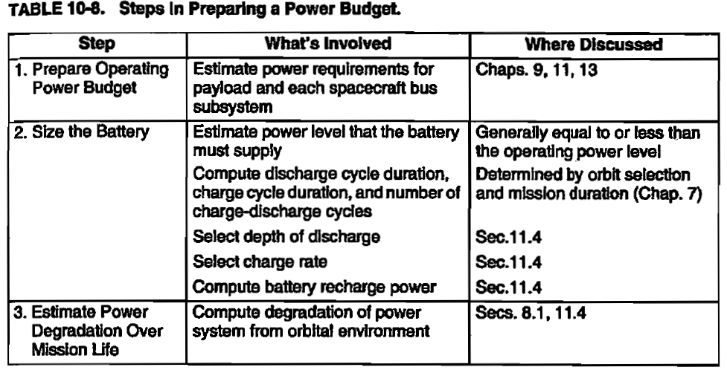
Power Budget
SMAD

Slide 13
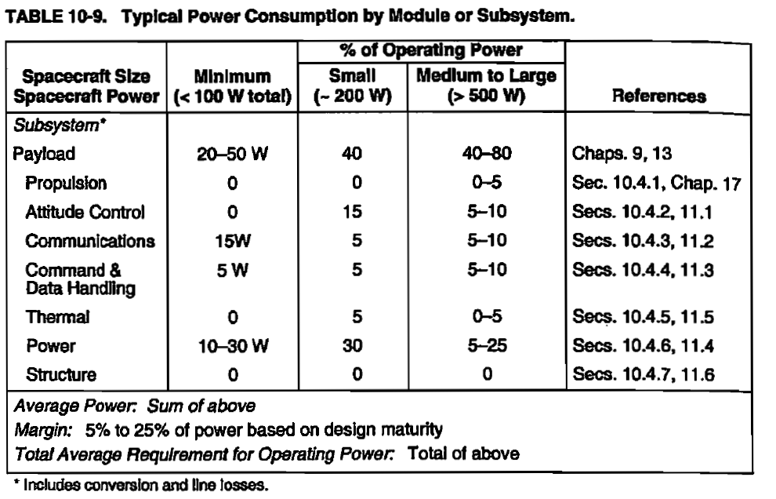
Power Budget (2)
SMAD

Slide 14
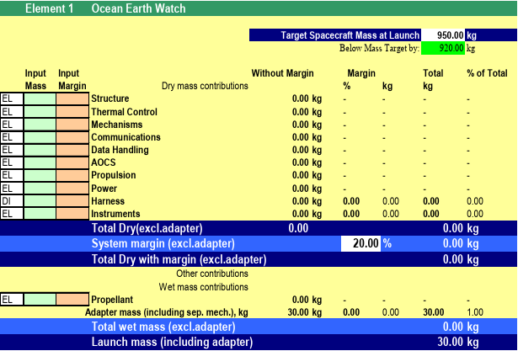
Mass Budget
Running total of spacecraft dry mass + propellant mass + margins.
Dictated by launch vehicle mass-to-orbit capability.
Mass budget is allocated to subsystems (payload, EPS, ADCS, thermal, C&DH, structures).
Margins
Each subsystem typically carries 5–25% margin to cover growth.
Bigger margin assigned for new/untested equipment
A small system-level margin is sometimes added on top.
Dry (no prop) vs. Wet mass (launch weight)
Payload is typically 15-50% of dry mass

Slide 15
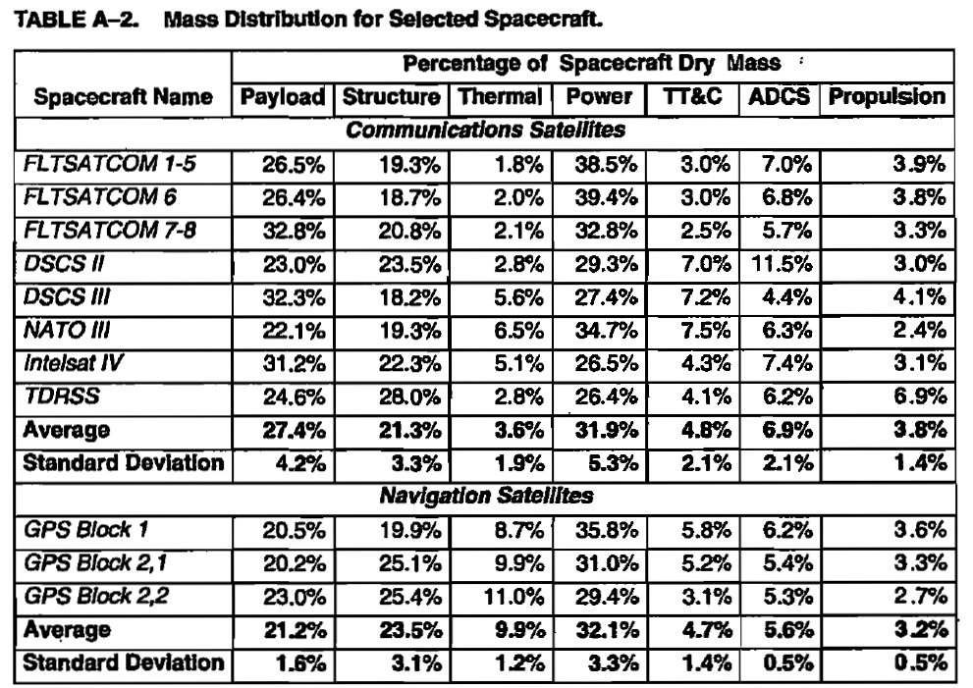
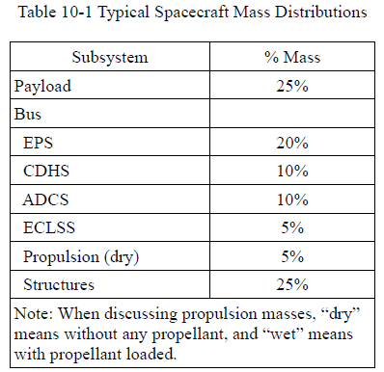
Mass Budget (2)
Dahlke
SMAD

Slide 16
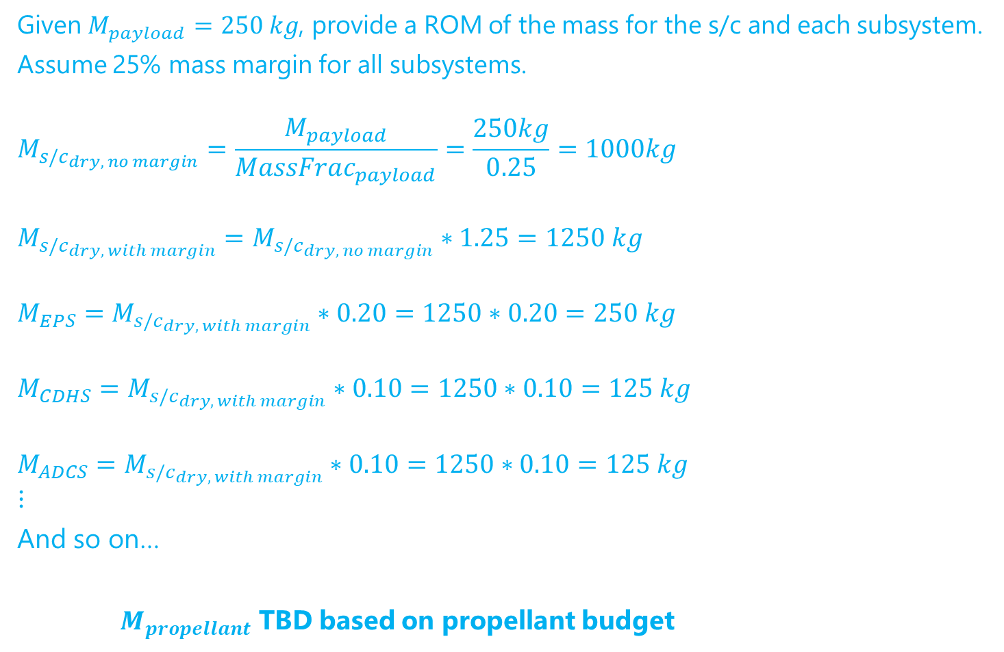
Mass Budget (example)
Given $M_{payload}=250 kg$, provide a ROM of the mass for the s/c and each subsystem.
Assume 25% mass margin for all subsystems.
$$M_{s/c_{dry, no margin}}=\frac{M_{payload}}{MassFrac_{payload}}=\frac{250kg}{0.25}=1000kg$$
$$M_{s/c_{dry, with margin}}=M_{s/c_{dry, no margin}}∗1.25=1250 kg$$
$$M_{EPS}=M_{s/c_{dry, with margin}}∗0.20=1250∗0.20=250 kg$$
$$M_{CDHS}=M_{s/c_{dry, with margin}}∗0.10=1250∗0.10=125 kg$$
$$M_{ADCS}=M_{s/c_{dry, with margin}}∗0.10=1250∗0.10=125 kg$$
$$⋮$$
And so on…
$M_{propellant}$ TBD based on propellant budget

Slide 17
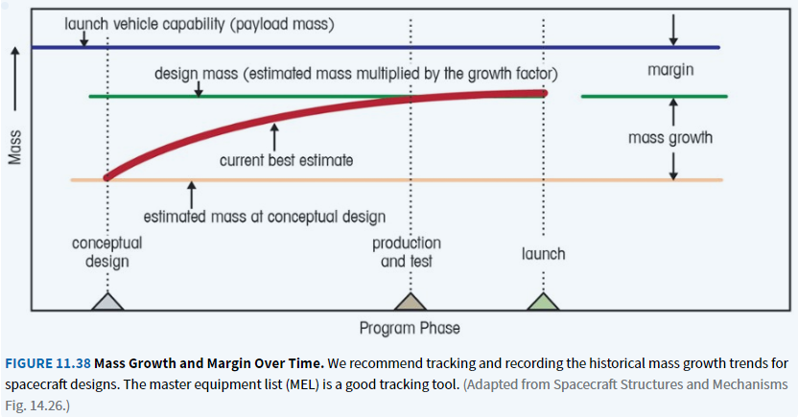
Mass Growth

Slide 18
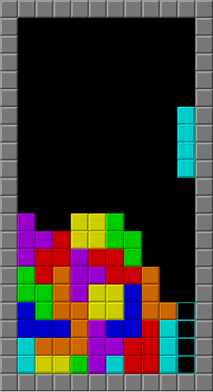
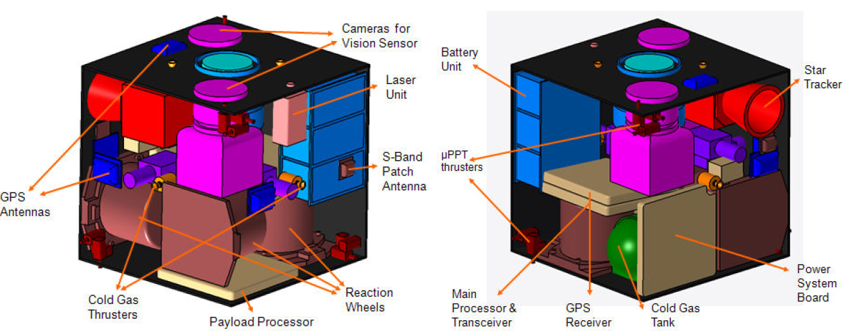
Volumetric (Configuration) Budget
Tracks physical space allocation inside spacecraft bus and payload fairing.
Ensures subsystems physically fit and don’t interfere.
Consider alternative form factors of components.
Tracked in CAD and using BOM
Notes:
Image from ANALYSIS OF ITÜ NXG I NEXT GENERATION TECHNOLOGY DEMONSTRATOR FROM A CONTROLS PERSPECTIVE

Slide 19
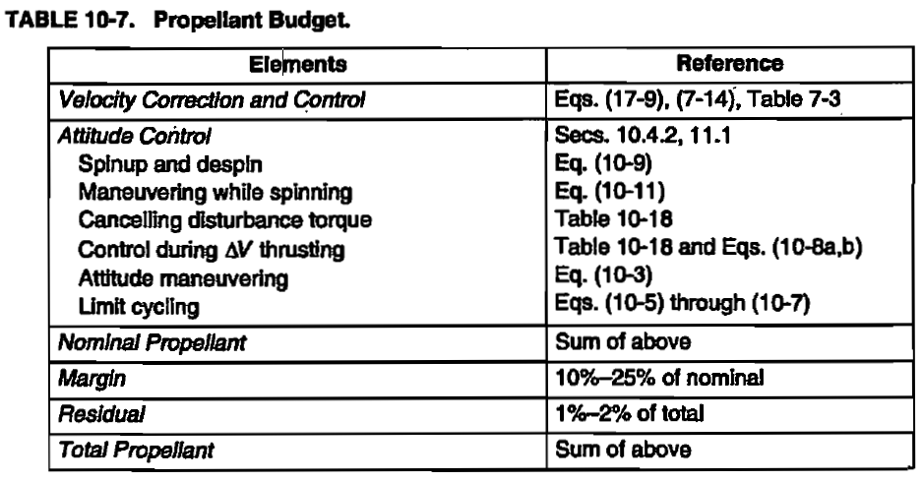
Propellant Budget
Tracks propellant needed for all anticipated maneuvers: orbit insertion, station keeping, attitude control, deorbit/disposal.
Expressed as ∆v requirements plus margins (often 10–20%) and residual (1-2%).
Tied directly to spacecraft lifetime and mission profile.
SMAD

Slide 20
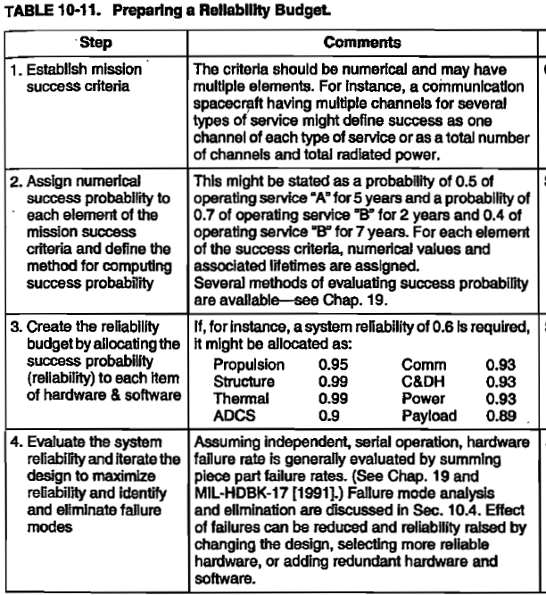
Reliability Budget
A structured way of ensuring that a spacecraft meets mission lifetime and success criteria by allocating, tracking, and managing reliability across subsystems.
SMAD
Summary of process*:
(1) A top-level requirement dictates overall success criteria, e.g.
“95% probability of mission success over 3 years”.
(2) Reliability for each subsystem is estimated.
(3) Estimate combined reliability of entire system.
(4) Track and iterate throughout design process.
Strategies to improve reliability:
Higher quality components
Redundancy
Component Derating
Radiation hardening
Fault detection and recovery
*dedicated lesson on Reliability latter in course

Slide 21
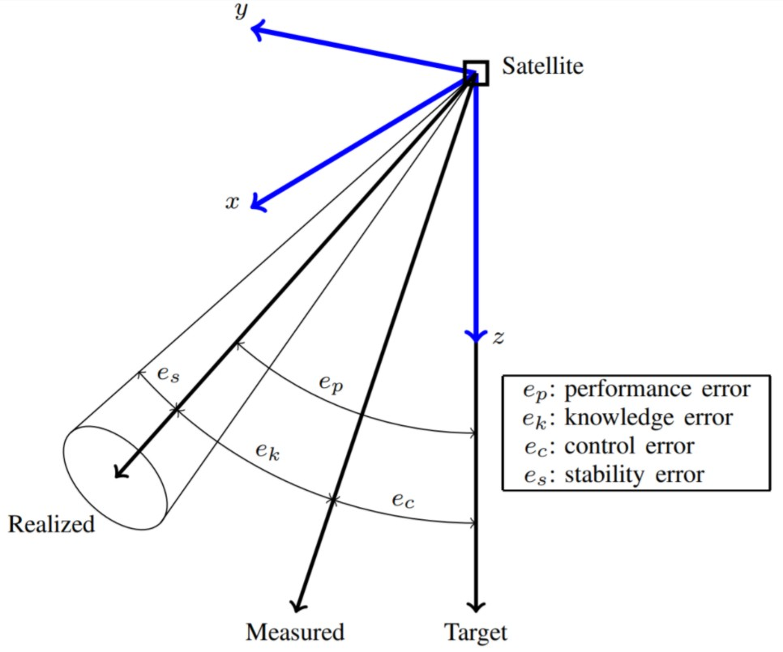


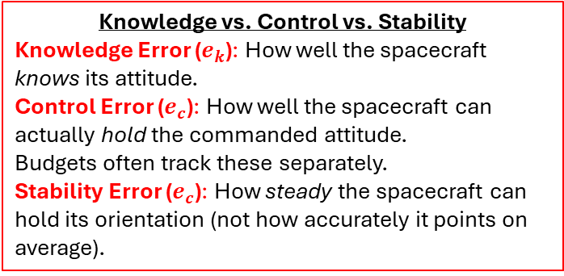
Pointing Budget
Accounts for all errors in spacecraft orientation to ensure antennas and sensors meet accuracy and stability requirements.
→ Breaks down all sources of error in the ADCS to ensure that overall pointing accuracy meets mission requirements.
What goes into Pointing Budget
Sensor Errors
Actuator Errors
GNC Errors
Estimation errors
Command-to-actuator discretization
Controller gain tuning
Structural and Environmental Effects
Mechanical flexing or vibrations
Thermal distortions
External torques
Knowledge vs. Control vs. Stability
Knowledge Error ($e_{k}$): How well the spacecraft knows its attitude.
Control Error ($e_{c}$): How well the spacecraft can actually hold the commanded attitude.
Budgets often track these separately.
Stability Error ($e_{c}$): How steady the spacecraft can hold its orientation (not how accurately it points on average).
Notes:
Sensor Errors
Star tracker noise and bias
Gyroscope drift and scale factor errors
Sun sensors / magnetometers accuracy
Actuator Errors
Reaction wheel torque ripple
Thruster misalignment / pulse errors
Magnetic torque coil inaccuracies
Control Algorithm Errors
Estimation errors from filters (e.g., Kalman filter)
Command-to-actuator discretization
Controller gain tuning
Structural and Environmental Effects
Mechanical flexing or vibrations (e.g., solar array jitter)
Thermal distortions (warping optics or structures)
External torques (gravity-gradient, solar radiation pressure, atmospheric drag in LEO)
Why It Matters
Remote Sensing Satellites: Image blurring if pointing stability is poor.
Astronomy Missions (e.g., Hubble, JWST): Require milli-arcsecond stability to observe faint objects.
Communications Satellites: High-gain antennas (Ka-band, optical comms) need sub-degree accuracy to avoid link loss.
CubeSats: Often limited by low-cost sensors/actuators, so pointing budgets may only allow coarse imaging or wide-beam antennas.

Slide 22
Pointing Budget (example)
Error Source | Contribution (arcsec)
Star tracker noise | 10
Gyro drift (between updates) | 5
Reaction wheel jitter | 8
Thermal flexing | 6
Navigation residuals | 4
Control error | 5
Total | 38

Slide 23
Cost Budget
Planned allocation of financial resources required to design, build, test, launch, and operate a spacecraft mission.
Cost of spacecraft/mission components
Major Space Mission Drivers
Spacecraft bus: Structures, power, propulsion, ADCS, C&DH.
Payload: Scientific instruments or comm packages (can be >50% of cost).
Ground segment: Ground stations, mission ops center.
Launch vehicle: Can be 20–50% of total mission cost.
Operations & maintenance: Staff, software, data handling.
Considerations:
Cost of R&D (people!)
Costs spread out over time
Phased Mission Costs (NASA/DoD style)
Phase A: Concept & feasibility
Phase B: Preliminary design
Phase C/D: Final design, integration, test, launch
Phase E: Operations
Phase F: Decommissioning/disposal

Slide 24
Schedule
Structured timeline of activities, milestones, and deliverables that defines when tasks must be completed to meet mission objectives.
Characteristics of a Good Schedule
Phased Planning
Missions are divided into phases (NASA: A–F). Each phase has clear entry/exit criteria.
Example: Phase C (detailed design) must finish before Phase D (integration and test) begins.
Milestones & Deliverables
Key checkpoints: Preliminary Design Review (PDR), Critical Design Review (CDR), Launch Readiness Review (LRR).
Milestones ensure stakeholders can track progress.
Critical Path
The sequence of dependent tasks that determines the minimum project duration.
Delays on the critical path directly delay the whole mission.
Reserves/Margins
Time “cushions” built into the schedule to absorb delays.
For spacecraft projects, schedule reserves are often 10–30% of task duration.
Dependencies
Some tasks must finish before others can begin (e.g., hardware delivery before integration).
Identifying these prevents bottlenecks.

Slide 25
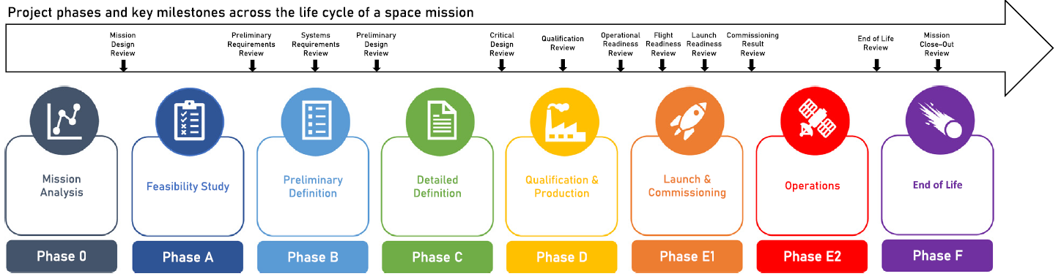
Space Mission Phases

Slide 26
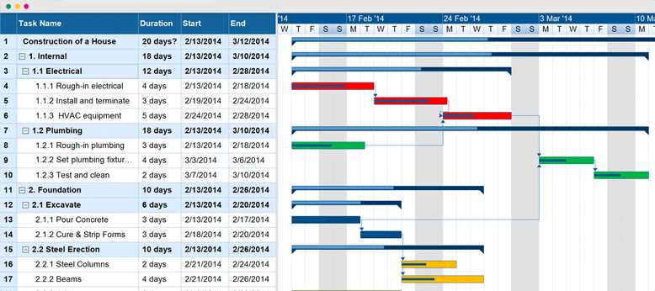
Scheduling Methods: Gantt Charts
Project management tool that visually displays tasks and their timelines in a bar chart format, showing start and end dates, durations, dependencies, and progress against a project schedule.

Slide 27
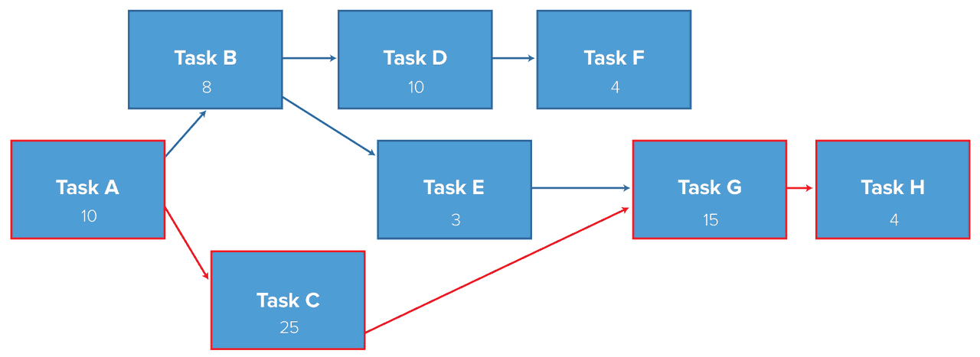
Scheduling Methods: Critical Path Method (CPM) / Workflow
Identifies the sequence of dependent tasks that determines the project’s minimum completion time.

